Slide 1
Task-2
Report
Title- found vulnerabilities using Netsparker
Domain- webappsecurity.com
SubDomain- zero webappsecurity.com

Slide 2
Steps-
Step 1: Add Website you want to s to the dialogue box.
Step 2: Define the customization option to scan as per your need
Step 3: It will start scanning it automatically
Step 4: Choose any one of the Critical Vulnerabilities.
Valnerabilities Details- netsparker Identify The You are using an
out of Version Of Tomcat
Impact- old version of software ,It may be attack of Valnerbilitles
Remedy- Please Upgrade On Installation Of Tomcat to latest version

Slide 3
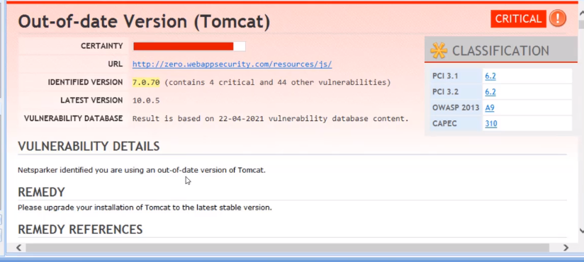
Screenshot-

